Slide 1
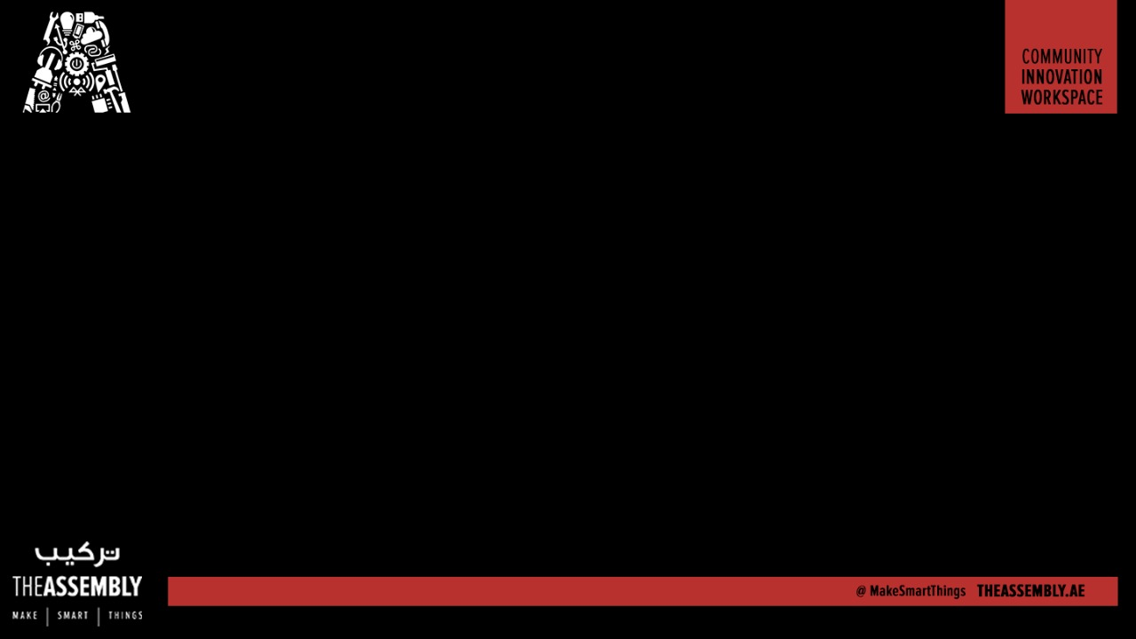
Make a Maze Learning MicroRobot
Presented By : The Assembly Team

Slide 2
Maze Solvers

Slide 3
What we are going to do

Slide 4
What else we could do
Notes:
*The HC-06 acts as a serial port through which you can send and receive data.
*So using a serial terminal or a Bluetooth customized application on your computer or phone, you can control and monitor your project.
*HC06 functions only as slave to a microcontroller

Slide 5
Break down of components

Slide 6
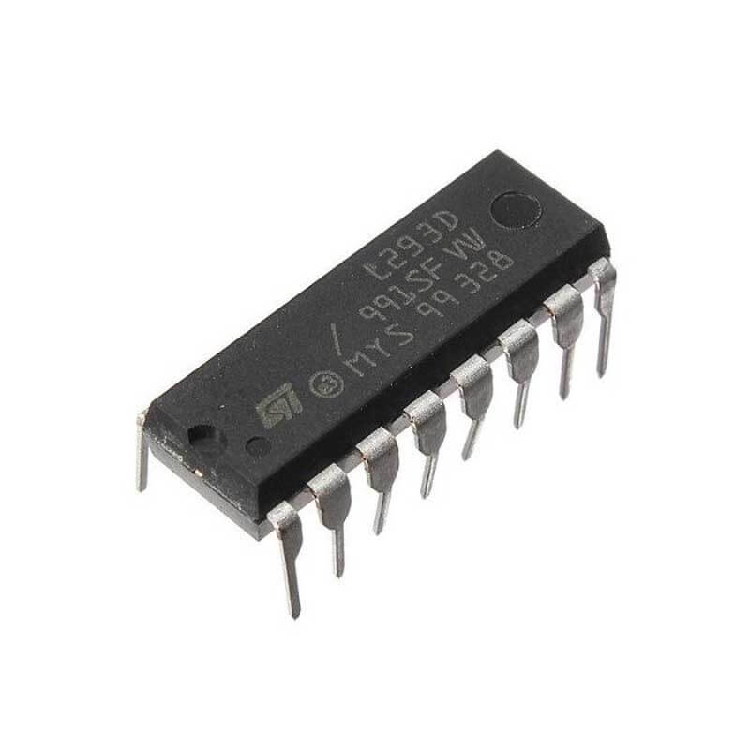
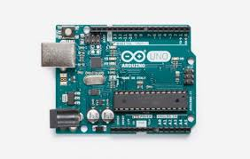
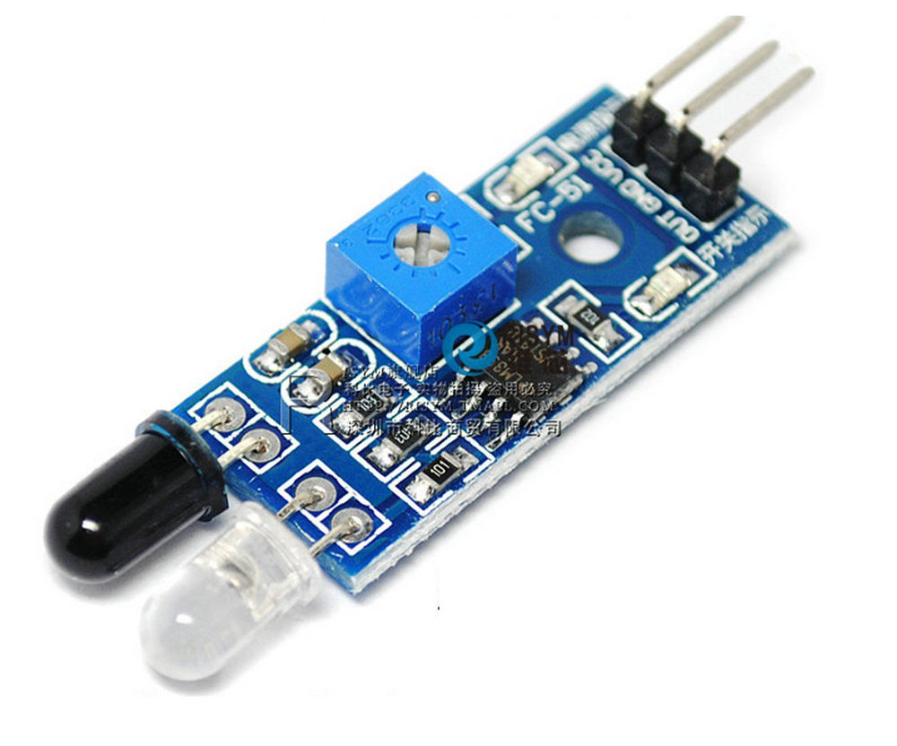

Slide 7
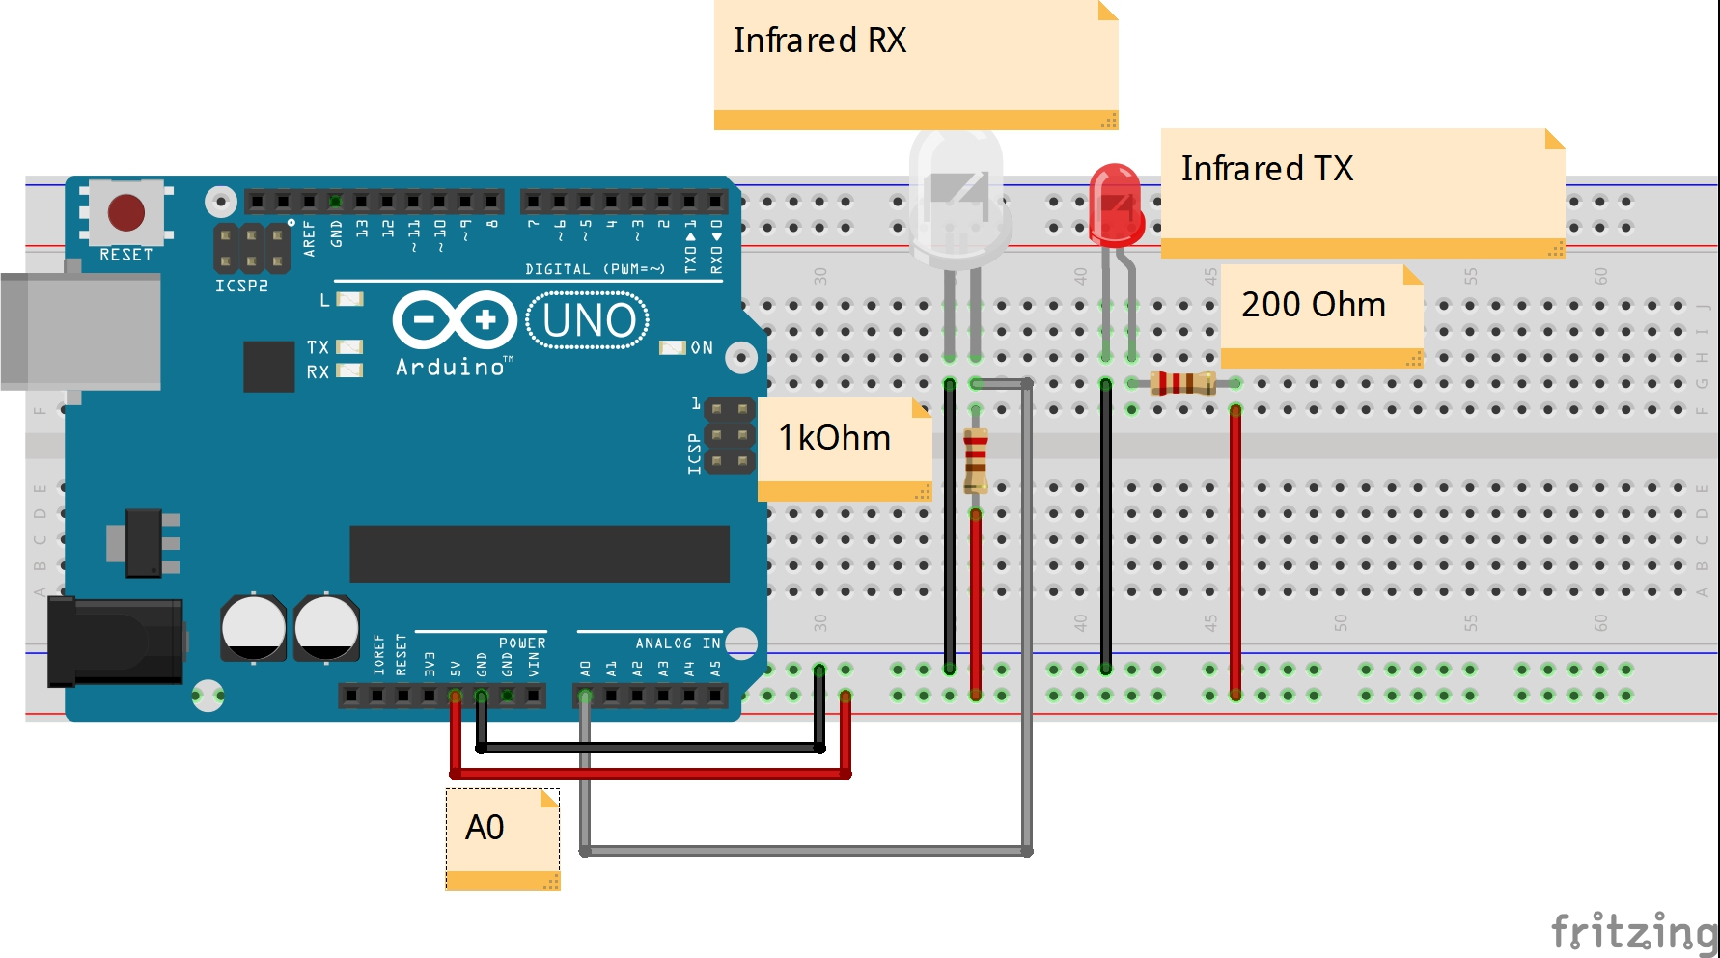
Infrared Modules

Slide 8
Do it 1 more time

Slide 9
Motor Driver, Uno and Motors

Slide 10
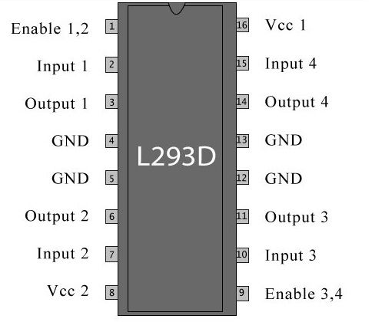
Motor Driver Pin out

Slide 11
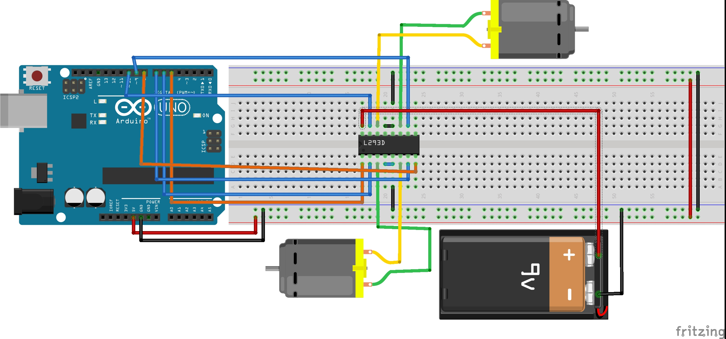
Notes:
Polylactic Acid (PLA)
Acrylonitrile butadiene styrene (ABS)

Slide 12
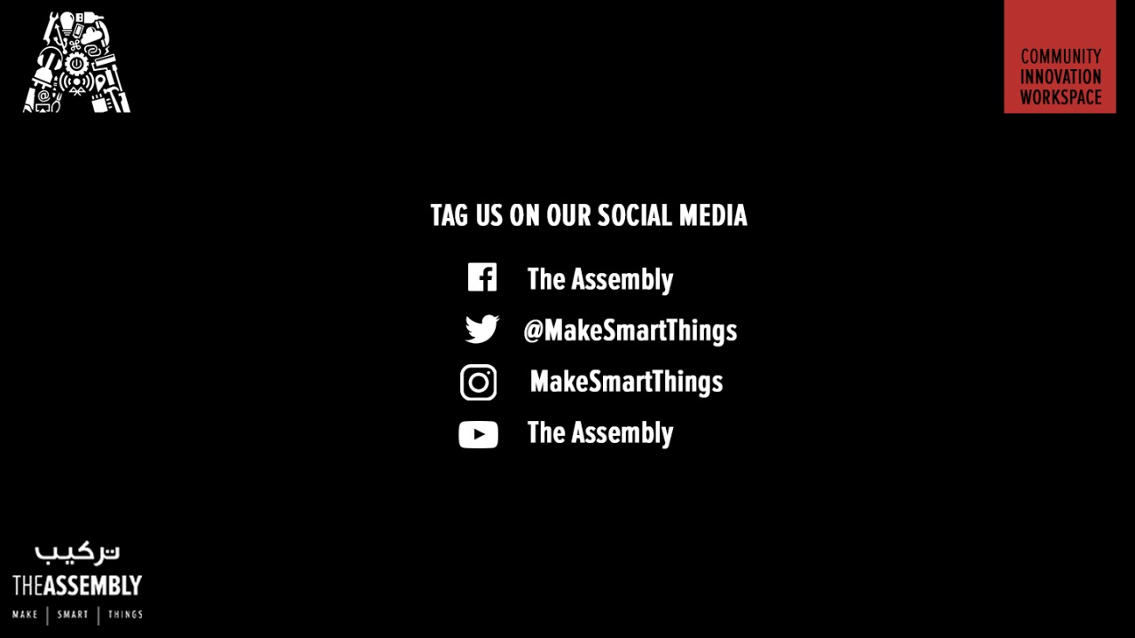
THANK YOU

